Slide 1
SI 507 Lab
Week 1
Sections 004/104 - Wednesday, 10-11:30am

Slide 2
Goals for today:
Admin stuff
Questions from Lecture
Lab Assignments - input() and functions
HW1 overview

Slide 3
About me
Name: Lea Wei (she/her)
Program: dual degree student in MSI and MAE (Applied Economics)
Programming experience:
Second time GSI for 507
Mostly work in Python, R, STATA, SPSS
Focus: Data analytics

Slide 4
Admin Stuff
Office Hours and Slack
Office hours
Group office hours (Fridays, 1-3pm, EST)
Individual office hours : Lea – Mondays 2-3:30pm by appointment
Slack - please sign up!
Slack Sign up: https://join.slack.com/t/si507fall21/shared_invite/zt-v0y29jxe-UF_MB4VglMvx8ZrKet6mCg

Slide 5
Admin Stuff
Course Materials and Homeworks
Course Materials:
Reminder: Lab recordings (from a single lab) will be uploaded weekly
Answers to lab exercises will be uploaded at the end of the week
Homework 1 has been released
Due in two weeks: Monday, Sep 13. by noon EST
Assignment and required documents available on Canvas in 'Assignments' tab

Slide 6
Admin Stuff
Lecture and Lab
Labs will be the most helpful to you if you have already 'attended' lecture for the week (either watched the videos or attended synchronously Tuesday morning)
We will often build on concepts introduced in lecture

Slide 7
Questions from lecture?

Slide 8
Files needed for today
Jump over to Canvas
Lab (Files → Lab Slides & recordings & Files → Lab Files → Lab 1 ):
lab1.py
Homework 1 files (Files → Homeworks → HW1):
hw1_overview_rubric.txt
hw1_sample_output.pdf
hw1.py

Slide 9
Small Group Lab Assignment:
functions and string functions refresher
Small group activity in breakout rooms (~15 minutes) At the following link: https://runestone.academy/runestone/books/published/py4e-int/functions/func-string.html
Introduce yourselves -- the more people in the course you know, the better!
Discuss each problem with your group (one person share their screen)

Slide 10
Small Group Lab Assignment:
functions and string functions refresher
Did any questions come up that you or your group struggled with? What were they?
If you need more of a refresher on functions, this may be helpful to go through on your own: (https://runestone.academy/runestone/books/published/py4e-int/functions/func-group.html)

Slide 11
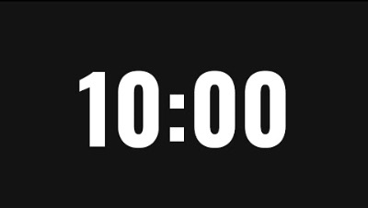
Lab Assignment 1
Exercise 1 - CelsiusToFarenheit()
user input and VALIDATION
basic function operations
Spend 10 minutes ON YOUR OWN working on Exercise 1.
Please do not consult with those around you (you eventually will, don’t worry!)
You can look up whatever you want!

Slide 12
Exercise 1, cont.
Continue working on Exercise 1 with a partner.
I’ll come around and give hints, if needed.

Slide 13
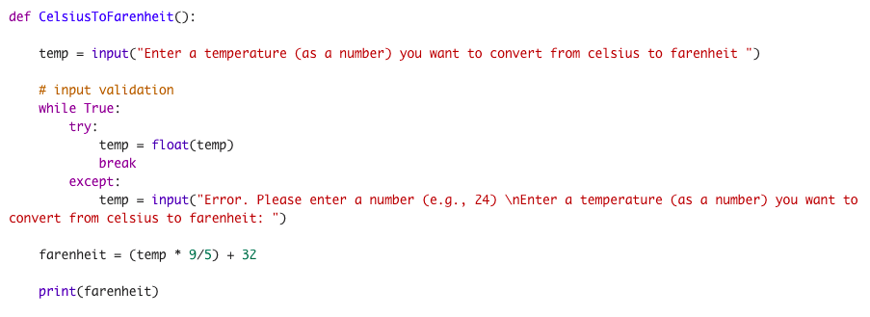
Exercise 1 Solution (Prof’s)
Questions or different methods?

Slide 14
Lab Assignment 1
Exercise 2A - MarketingCampaign()
slightly more advanced function operations

Slide 15
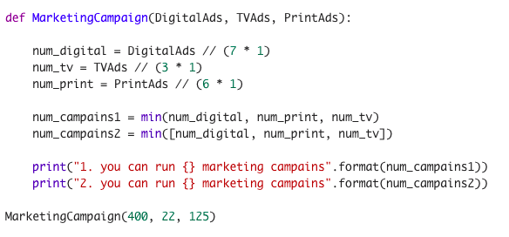
Exercise 2 Solution (Prof’s)

Slide 16
Lab Assignment 1
Exercise 2B - MarketingCampaign2()
Add input functionality to MarketingCampaign()
more input validation

Slide 17
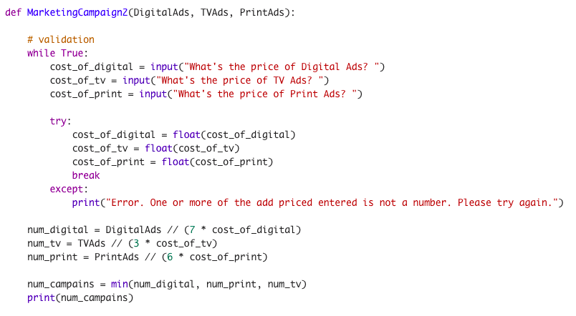

Slide 18
HW1 - tic-tac-toe
Overview
Rule: https://www.youtube.com/watch?v=USEjXNCTvcc&feature=share

